Slide 1

Performance Review:
the significance of the
nfl combine
STAT 306: Multivariate Sports Analytics
2.02.2024

Slide 2


Table Of Contents
Look out for blue underlined text!
Motivation and Background
Regression Analysis
Motivations, Data, and existing Research
Initial analysis and concerns with multiple linear regression
Problem solving & principal component analysis
K-Means Clustering
Problem solving, PCA, and nonparametric regression techniques
Clustering algorithm to find “natural” positions
Notes:
A

Slide 3
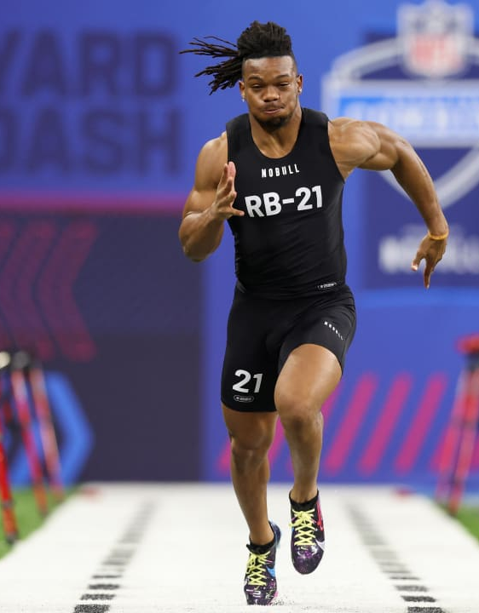

Why the NFL combine?
The NFL Combine is one of the few benchmarks done consistently for past and present NFL Players
Unique data across many years
Relatively uncertain on the importance of the combine
What if we use combine data in the presence of other performance metrics?
Existing Research
Existing research finds little to no relationship between combine and NFL performance
This may be because a certain level of quality is required to be invited
Articles in Google Drive folder detail this more!
Notes:
A

Slide 4
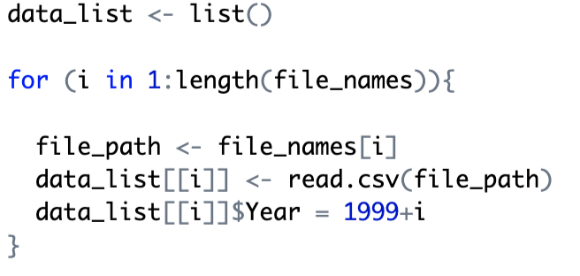
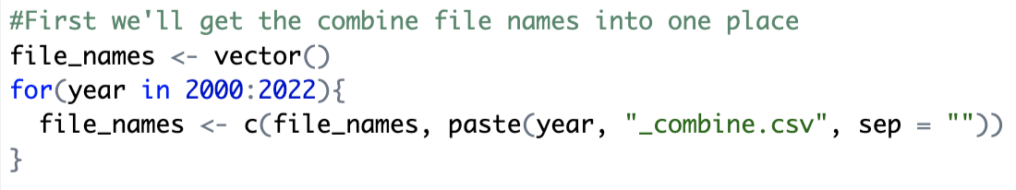
Data used for analysis
NFL Combine Data (Via Kaggle) from 2000-2018
NFL Pass-Defender Data (also Via Kaggle) from 2018
Merged the many datasets into one large dataset
121 Pass-Defenders have both full combine and performance data
Challenges with data wrangling and fixes!
Notes:
V

Slide 5

Regression Analysis
Notes:
A

Slide 6
Regression Analysis & Findings
Started with full regression model (Adjusted R-squared = 0.8166)
Used manual elimination to improve model (Adjusted R-squared = 0.823)
Significant variables: Experience, position, incompletion rate, interception rate
Height and combine vertical jump also significant at 10% level
Without incompletion/interception rate, adjusted R-squared = 0.649
This only uses vertical, height, experience, and position
but…
Notes:
A

Slide 7
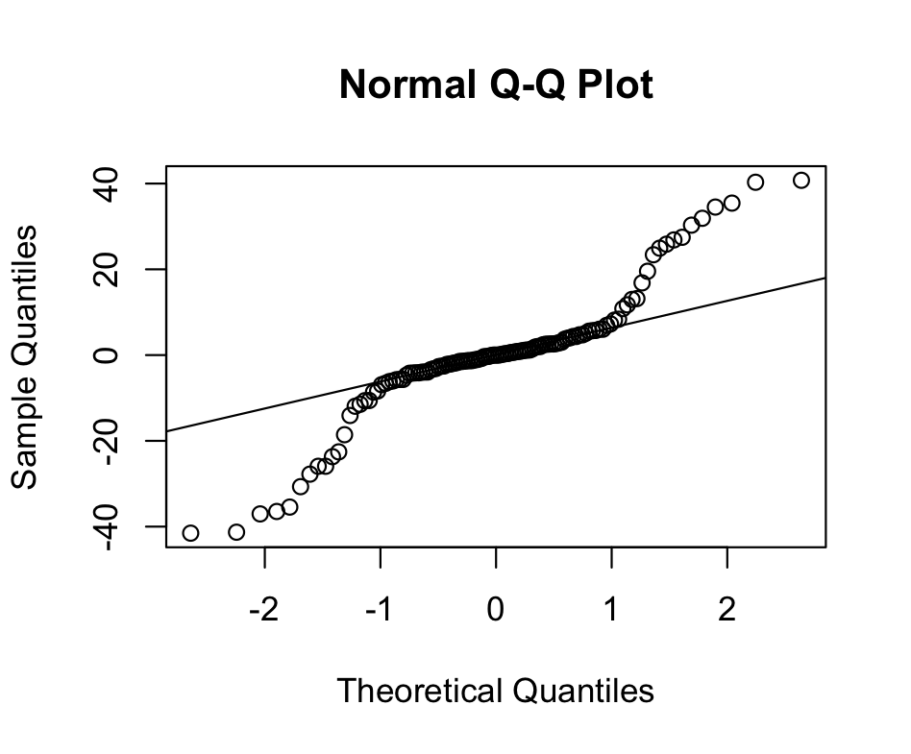
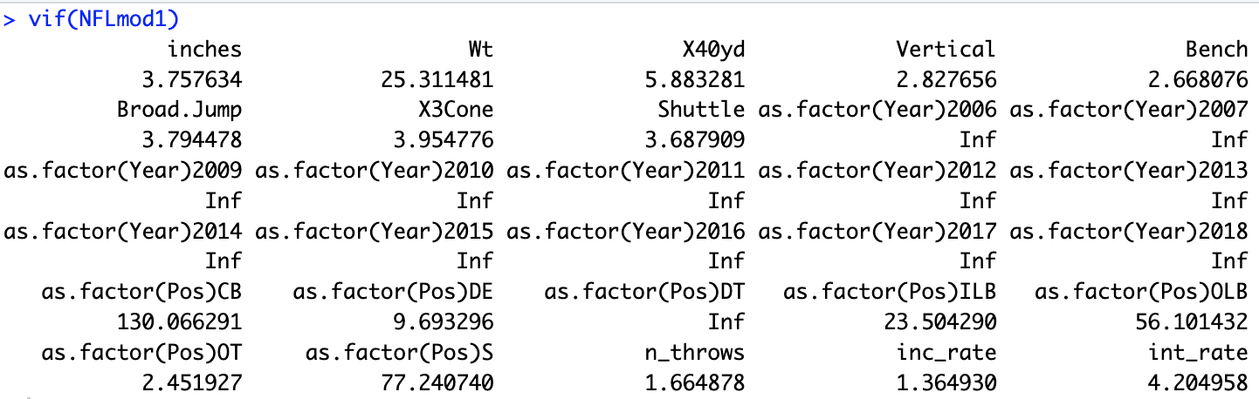
conditions!!
Particularly Bad VIFs
Notes:
A

Slide 8
Concerns with Regression
Normality concern: Nonparametric multiple regression
Used rfit package with new adjusted R-squared of 0.636
Incompletion rate significant at the 1% level
Vertical jump still significant at 10% level
Some positions (linebacker and defensive end) also significant
Testing with Variance Inflation Factors (VIFs)
Addressing multicollinearity concern with principal component analysis (PCA), and why it’s not perfect for this use-case
Notes:
V

Slide 9
Regression Conclusions
Conditions ultimately make parametric models unusable
Nonparametric substitute isn’t as strong of a predictor, but still explains much of the variance in performance
Generally, confirmed existing research that combine data isn’t very useful in predicting NFL success
except for vertical jump in pass-coverage!
Multicollinearity and PCA investigation led us to another big research question!
Notes:
V

Slide 10
K-Means Clustering
Notes:
A

Slide 11
Clustering applications
Sometimes multi-position athletes will strategically decide their “position” for the combine based on how they expect to perform
Ex: more appealing to be fastest linebacker than 5th fastest safety even though your 40 yard dash time would be the same
Players may also be better fit for a different position based on their physical attributes, and a switch in the pros may unlock potential
K-Means clustering could offer alternative positional groupings to traditional roster designations
Notes:
A

Slide 12
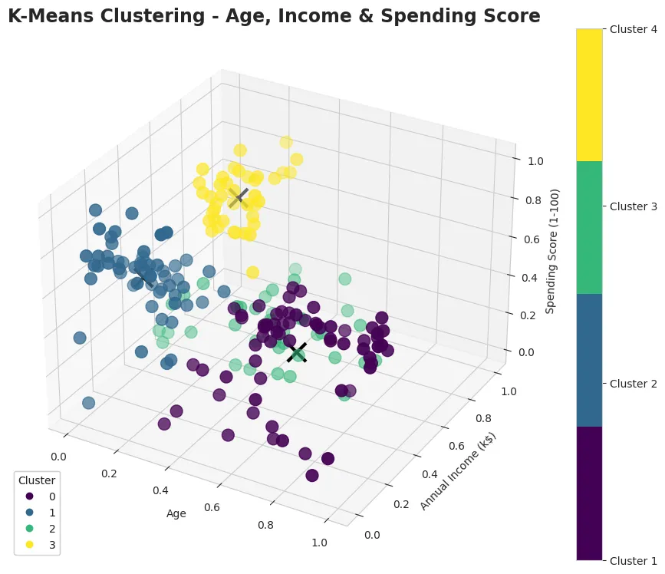
What is k-means clustering?
Unsupervised Learning Algorithm that finds patterns and groups accordingly
uses a pre-specified number of groups
Example image: Customer segmentation
Learn More Here! (python in article)
Doing K-Means in R
Our uses for K-Means Clustering
Removing position and seeing what natural groupings emerge
Notes:
V

Slide 13
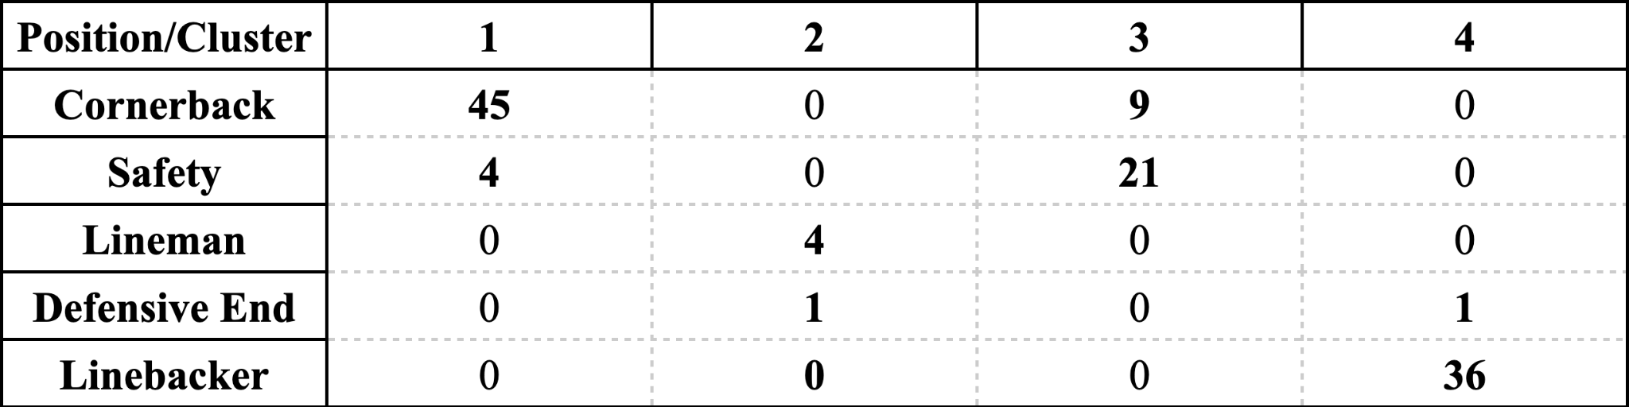
Height, weight, 40 yard dash, vertical, bench press, broad jump, 3 cone drill, shuttle drill
Inputted Variables:
Clustering algorithm
Surprisingly good groupings!
Notes:
V

Slide 14
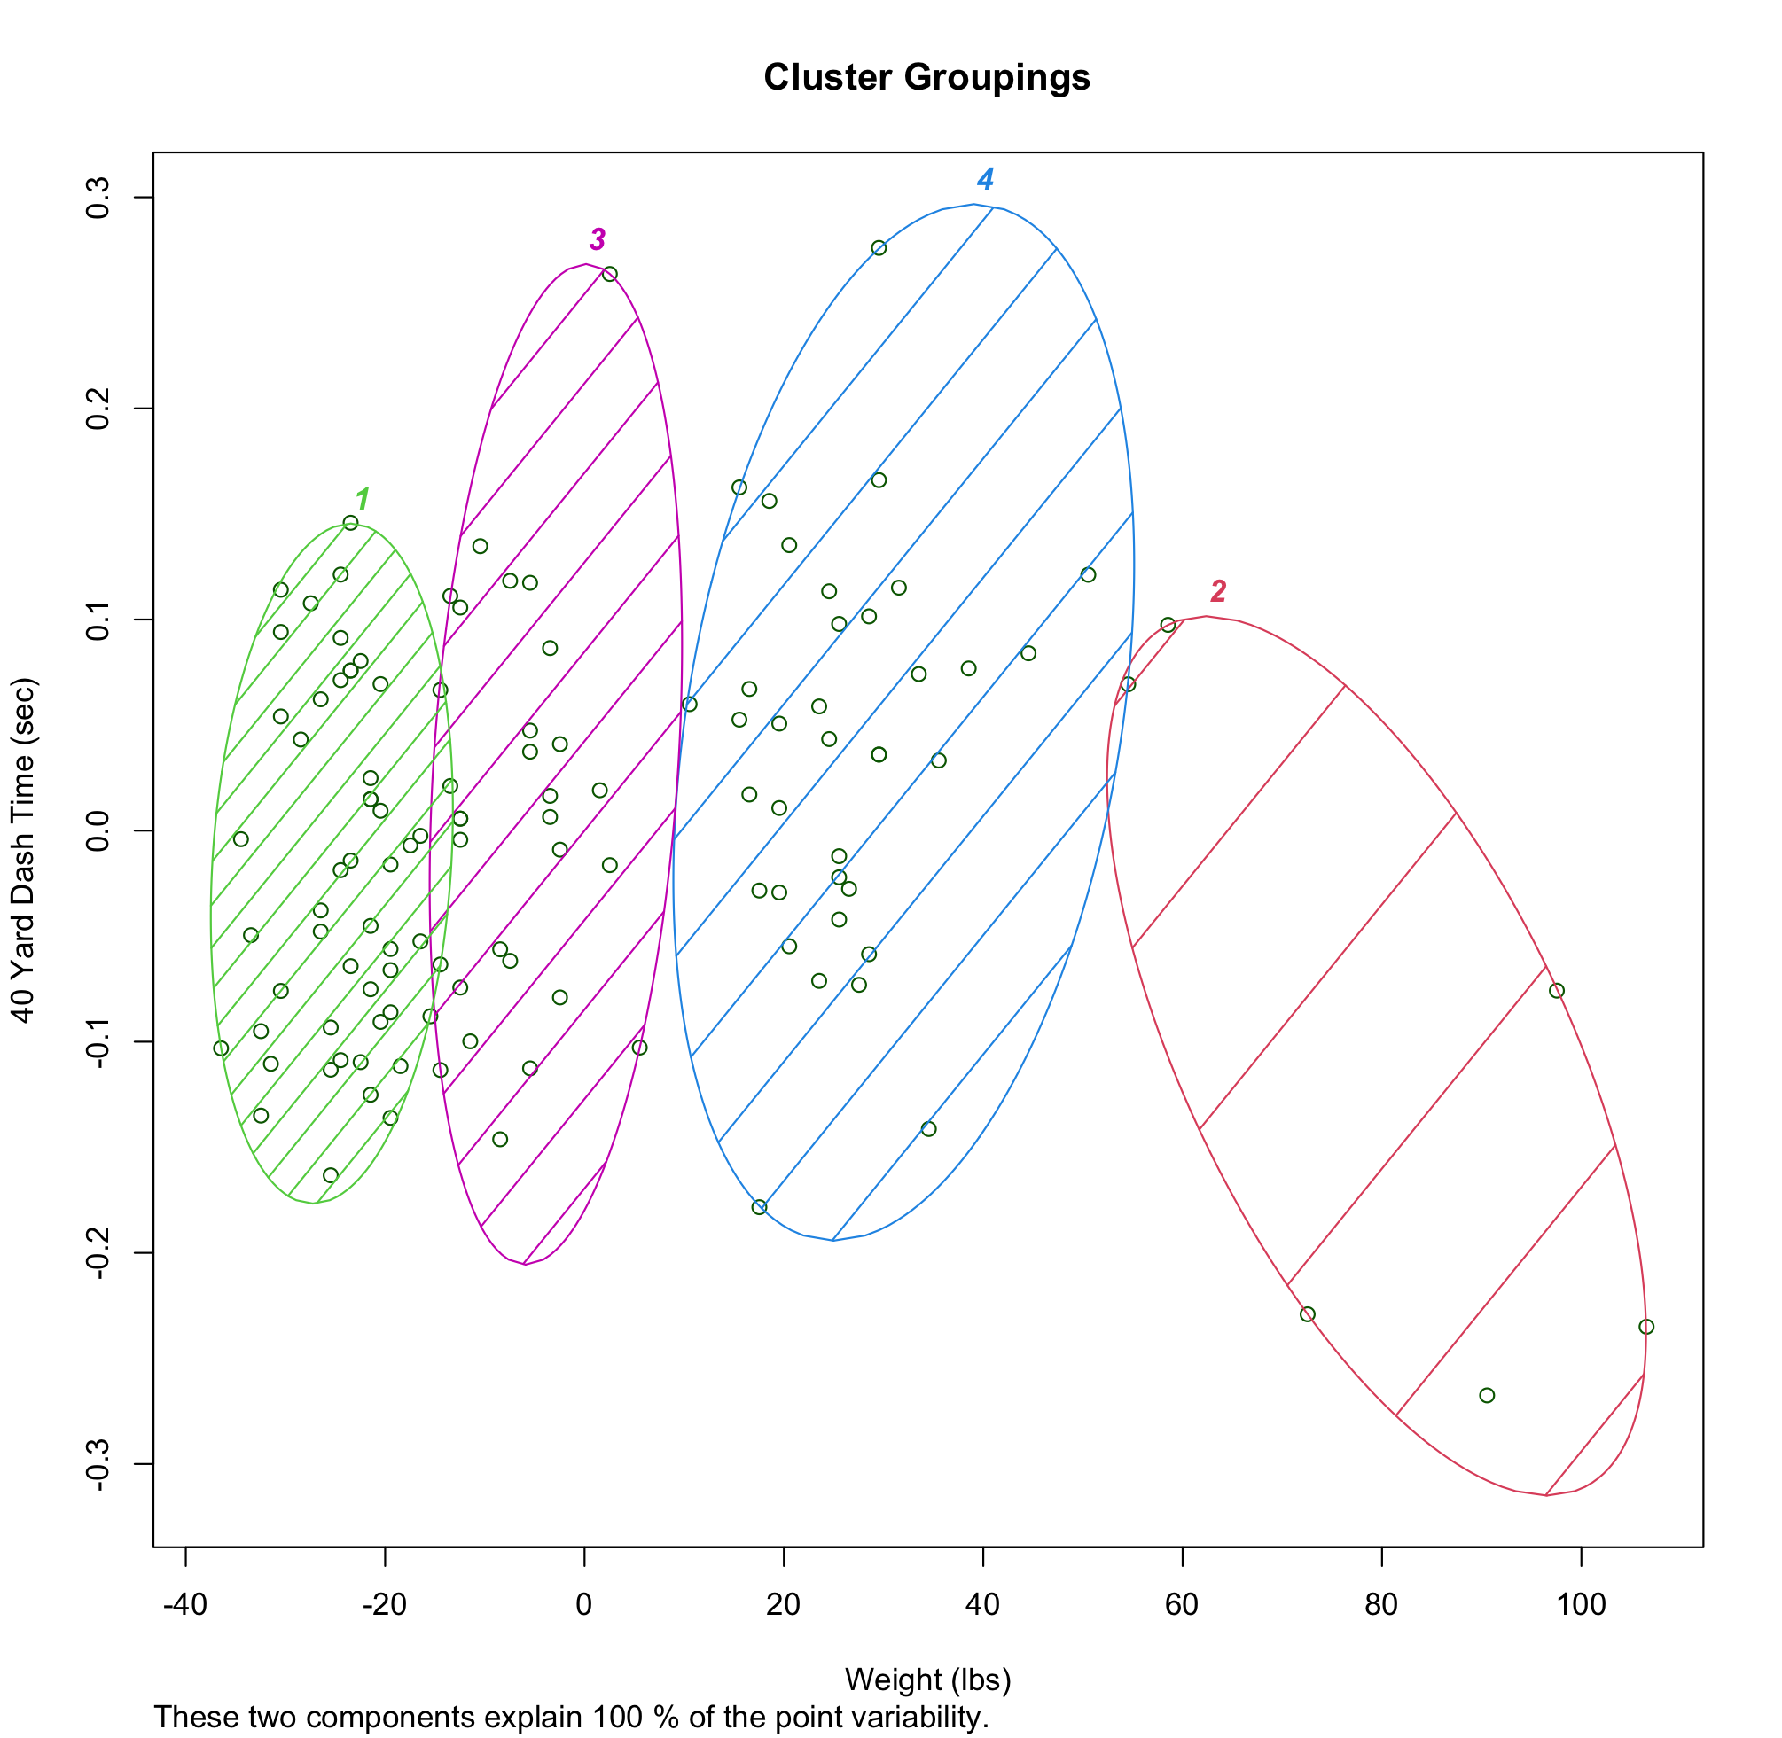
Our Findings
Surprisingly good accuracy for classification of clusters!
We believe that this would be usable by NFL front offices when considering versatility of players
Could also help players decide what position to list themselves as when entering the NFL draft
*Note that axis scale shows distance from mean
Notes:
V

Slide 15
Summary & Final Conclusions
Data Wrangling Techniques
Regression Analysis
Discussed easily importing many csv files to R
Multiple linear regression, conditions, and concerns
Problem solving & principal component analysis
K-Means Clustering
Practical applications and benefits of using clustering algorithms
Discussing PCA, nonparametric regression, and other problem solving techniques
Notes:
A

Slide 16
Thank You! Any questions?
Sources:
https://medium.com/@robertb909/k-means-clustering-a64f859a1074
https://www.geeksforgeeks.org/k-means-clustering-in-r-programming/#
https://cran.r-project.org/web/packages/Rfit/Rfit.pdf
https://www.r-bloggers.com/2021/05/principal-component-analysis-pca-in-r/
https://www.kaggle.com/datasets/chipkajb/nfl-bdb-data
Research Articles in Google Drive

